Slide 1
PSO Algorithm
PSO implementation for Single Target Searches
Aniket Tambe
NEU-ID - 001676008

Slide 2
PSO Application
By using swarm intelligence for searching applications, low cost, dispensable robots can be used to accomplish tasks that would otherwise be impossible by humans or extremely expensive.
The PSO particles are considered are as mobile robots and the guiding of these individual robots towards the target is carried out using the PSO algorithm.

Slide 3
Particle Swarm optimization
The system initially has a population of a random solutions where each potential solution is called particle.
Each particle is given a random velocity and is flown through the problem space.
The particle keeps track of its previous best position(pbest) & it fitness. Among the swarm the particle with great fitness is called gbest of the swarm.
Every particle in swarm is accelerated towards its pbest and gbest locations with a random weighted acceleration at each step.

Slide 4
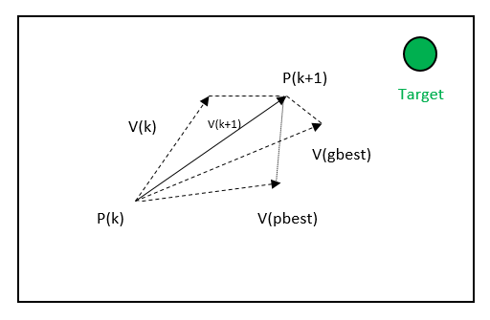
PSO Implementation

Slide 5
PSO Details
P(k) is the initial location of particle in free space.
V(k) is the initial velocity.
P(k+1) is the modified particle location.
V(k+1) is the modified velocity.
V(pbest) is velocity for pbest location.
V(gbest) is velocity for gbest location.

Slide 6
PSO Equations
To calculate fitness simple formula to find distance between two points in 2D space is used.
Fitness = sqrt((Px-Tx) +(Py-Ty))
Tx,Ty = Target x and y coordinate
Px,Py = Particle current x and y coordinate
V(kx+1) = Vkx +c1 * rand()*(pbestx - x)+c2 * rand()*(gbestx-pbestx)
c1 and c2 are constant and in my algorithm is set as 2.
Similar to above equation the velocity Vy is updated.

Slide 7
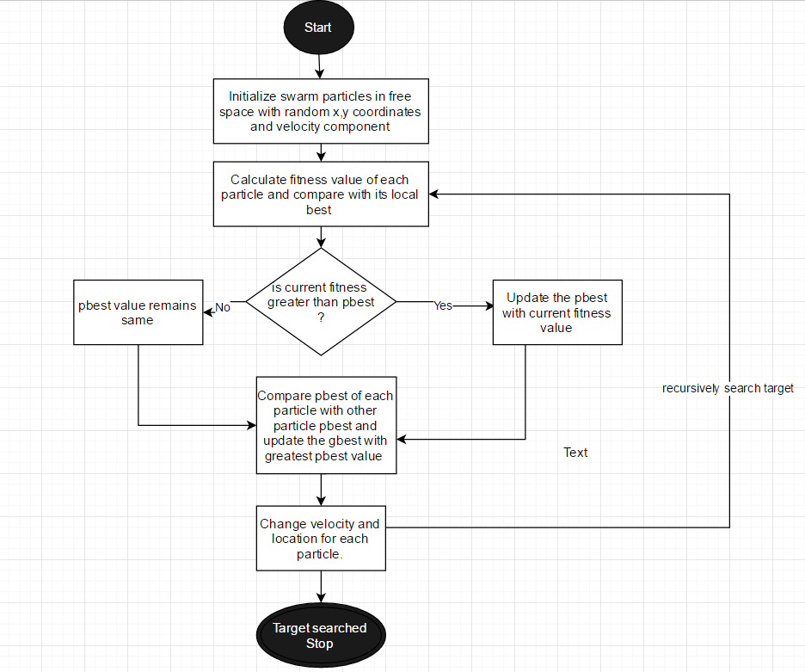
FlowChart

Slide 8
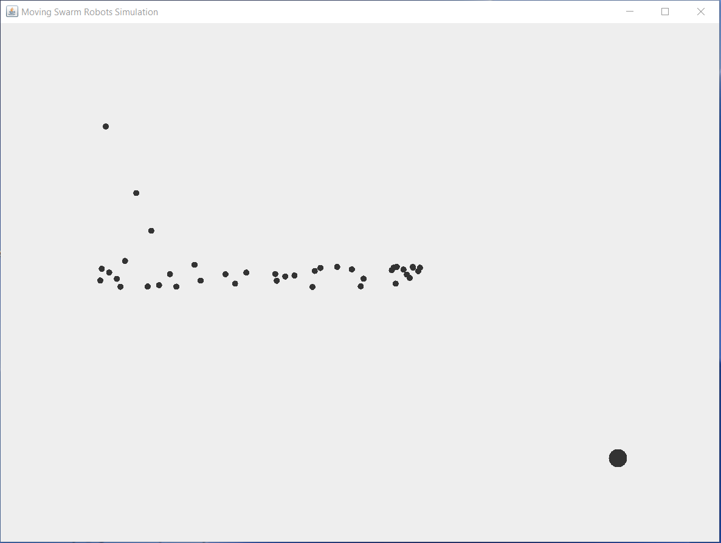
Execution

